Slide 1
PAM Algorithm
Tal Gaon
Yovel Gabbay

Slide 2
Algorithm – PAM
Partition Around Medoids
PAM is a clustering algorithm similar to k-means, using actual data points as medoids instead of centroids.
PAM attempts to minimize the total distance between points within a cluster and their corresponding medoid. The goal is to find each cluster's most centrally located data points.
Unlike k-means, which minimizes the sum of squared Euclidean distances, PAM minimizes the sum of pairwise dissimilarities. This makes PAM more robust to noise and outliers, as it doesn't rely on the cluster’s mean.

Slide 3
Algorithm – PAM
Partition Around Medoids
Step 1: Randomly select k initial medoids from the dataset.
Step 2: Assign each point to the nearest medoid, forming clusters.
Step 3: Update medoids by finding a point in each cluster that minimizes the total distance to other points in the cluster.
Step 4: Repeat until medoids do not change or a stopping criterion is met.

Slide 4
Python
Advantages:
Numpy:
  Numpy makes matrix operations and numerical computations efficient and easy to implement.
  Enable fast development.
Python’s syntax is straightforward and readable, making writing, debugging, and maintaining code easier.
Disadvantages:
Performance Limitations:
  Python is an interpreted language and can be slower than compiled languages like C or C++. This can be a bottleneck when dealing with large datasets in PAM
Python's automatic memory management can sometimes lead to higher memory usage compared to lower-level languages. For large datasets, this could be a constraint.

Slide 5
Python - Optimization Techniques
Efficient Data Handling and Matrix Operations with Numpy
Submatrix Extraction to Minimize Repeated Access
  This technique saves a submatrix to prevent multiple accesses to the large matrix, reducing computational overhead and improving performance.

Slide 6
Haskell
Advantages:
Strong Typing and Immutability:
  Type Safety: Haskell's static type system catches errors at compile-time, reducing bugs in complex algorithms like PAM.
  Immutability: Immutable data structures ensure safer and more predictable code.
Lazy Evaluation:
  Efficiency: Calculations are only performed when needed, potentially improving performance in PAM's resource-intensive operations.
Disadvantages:
Steeper Learning Curve
  Functional Paradigm: Haskell’s functional approach and abstract concepts can be challenging for developers used to imperative languages, making PAM implementation more difficult.

Slide 7
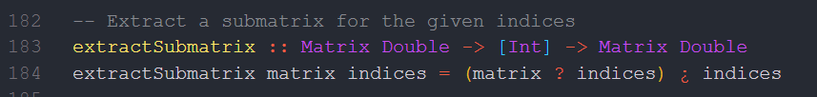
Haskell - Optimization Techniques
Efficient Use of HMatrix for to efficiently handle large matrices and perform operations
  like submatrix extraction and distance calculations.
Recursive Accumulation and Tail Recursion
  Example: silhouetteScoresRecursive in the silhouette score calculation.
  Making the algorithm more memory-efficient
Submatrix Extraction to Avoid Repeated Access
  Reduces repeated access to large data structures, enhancing performance.

Slide 8
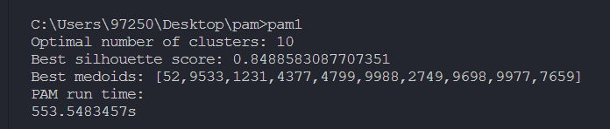
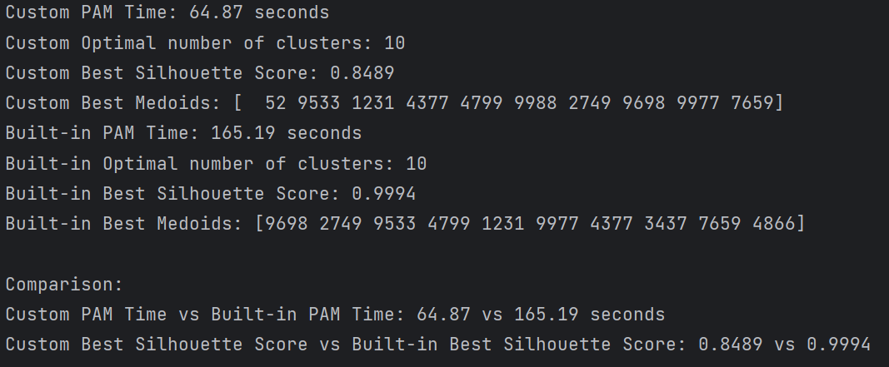
Comparison
Haskell
Python

